Slide 1
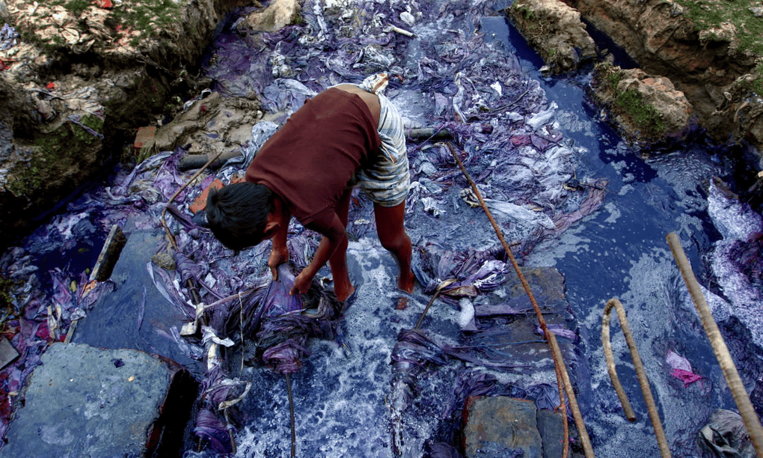
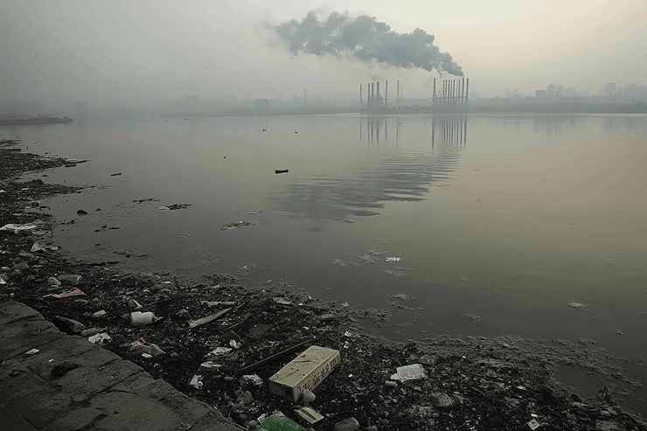
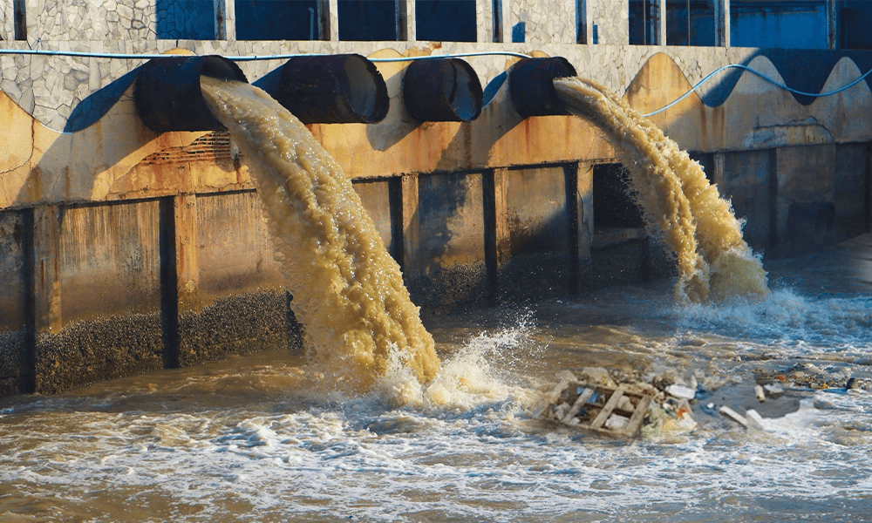
WATER POLLUTION

Slide 2
WATER POLLUTION
Main sources of water pollution
Industrial waste
Domestic waste
Agricultural runoff
Arsenic contamination
Climate change impacts
Sewage Discharge
Waste Dumping (Solid Waste)
River Dumping
Oil Pollution

Slide 3
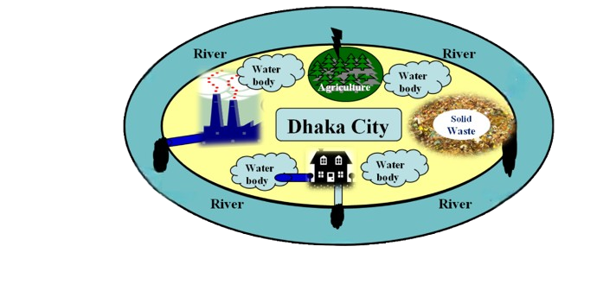
WATER POLLUTION
60,000 m3 toxic waste everyday
7000 tons everyday
7.7 million L liquid waste from tanneries
8888 million tons of solid waste from waste tanneries
Textile industries annually discharge as much as 56 million tons of waste and .5 million tons of sludge

Slide 4
WATER POLLUTION
Consequences of water pollution
Serious health risks
Dead rivers
Loss of biodiversity
Unsafe drinking water
Groundwater depletion
Economic damage
Bad odour & poor living conditions
Spread of waterborne diseases
Damage to agriculture
Threat to future generations

